Slide 1


Enron North America
Investment Portfolio
Activity Reporting & Analysis
Report Date- July 21, 2000
Confidential

Slide 2
Investment Portfolio Activity Reporting & Analysis
Project Objective:
The purpose of our review was to understand the process by which the Investment Portfolio is updated and reported during daily and quarterly revaluation. Our review was designed to identify and test significant policies, procedures, and controls to ensure the information reported properly reflects investment values and is updated and distributed to the appropriate parties timely and accurately.
AA Team Members: Enron Team Members:
Tom Bauer Wes Colwell
Patricia Grutzmacher Andrea Reed
Derek Claybrook Todd Hall
Carrie Applewhite David Maxwell
Michael Croom Susie Ayala
Tatiana Waxler

Slide 3
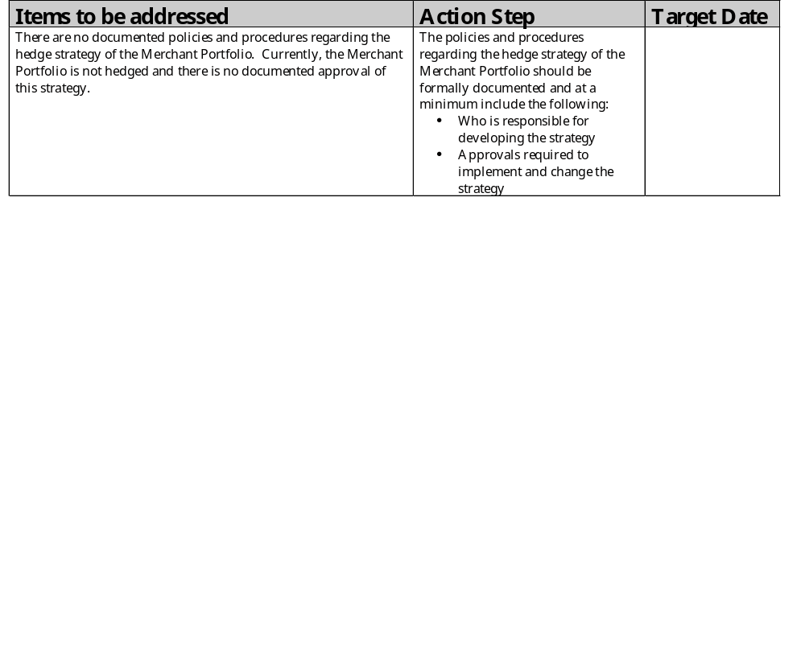
Investment Portfolio Activity Reporting & Analysis

Slide 4
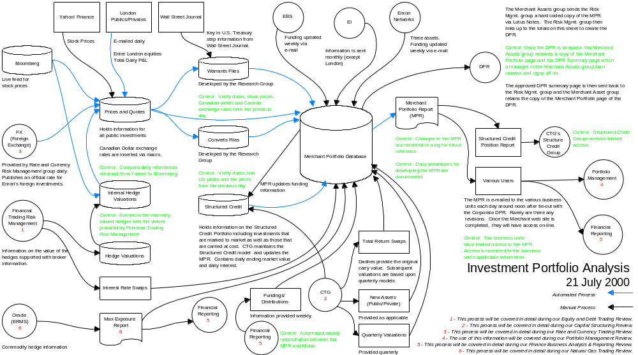
Investment Portfolio Activity Reporting & Analysis

